Slide 1
STUDENT MANAGEMENT SYSTEM
BSIT21054 - Web Programming BY: Group C

Slide 2
INTRODUCTION
A Student Management System (SMS) is a system that can handle all the details about students.
The details include
college details,
course details,
students’ personal details,
academic details
etc.

Slide 3
Extensive information is available at your fingertips through this system.
Viewing student data, managing, subject management, department, class, program and related issues are made simple and easy.
There are custom search capabilities to aid in finding student information and working on student records.
This can make the system easier to navigate and to use maximizing the effectiveness of time and other resources.
Student Management System allows the keeping of personnel data in a form that can be easily accessed and analyse in a consistent way. The Student Management System is an automated version of manual Student Management System.​

Slide 4
OUR OBJECTIVES
Student Management System is a management information system for education establishments to manage student data.​
It provides capabilities for registering students in courses, Admitting students, tracking student information.​
Ensure data integrity, privacy and security in an open – access environment.

Slide 5
PROJECT CATEGORY
It is a web-based application.​
Unlike traditional applications, it is accessible anytime, anywhere, via a PC with an internet connection.​
It need lower requirements on the end user system and simplified architecture.​

Slide 6
TOOLS AND PLATFORMS
We have used PHP for back-end, HTML, CSS and JavaScript for the front end of this project
For saving the data of students we have used MySQL database.
The entire website executes on the XAMPP server.
To access the website we can use any type of web browser.

Slide 7
HARDWARE AND SOFTWARE REQUIRMENENTS
Offline Version
Web browser
Google Chrome
Firefox
Internet Explorer
System Requirement
OS : Windows 7/8/8.1/10
RAM : 2 GB
HDD : 250 MB
Processor : Intel Dual Core or higher
Web Based Version
Web browser
Google Chrome
Firefox
Internet Explorer
Internet Connection with good speed.

Slide 8
SYSTEM DESIGNS

Slide 9
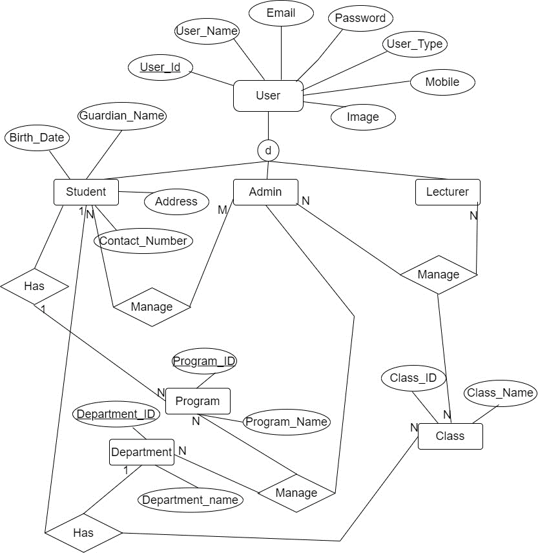
ER DIAGRAM

Slide 10
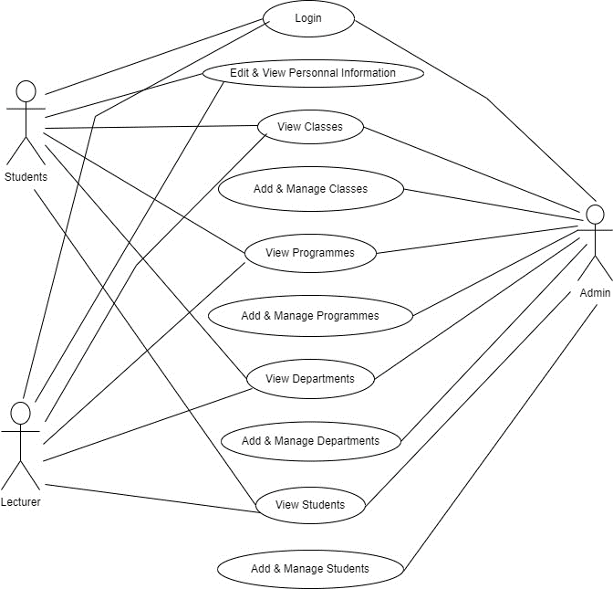
USE – CASE DIAGRAM

Slide 11
the project flow
Step 1:- Making the SRS.
Step 2:- Coding and development
Coding for database
Coding for web interfaces
Connectivity of Databases
Step 3:- Testing
Functionality Testing
Interface Testing
Performance Testing
Implementation & Maintenance

Slide 12
system installation

Slide 13
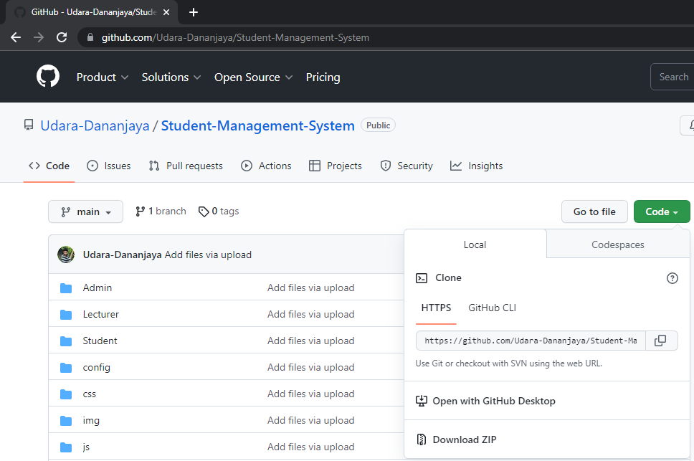
Download From GIthub
URL : https://github.com/Udara-Dananjaya/Student-Management-System
Click On this “ Code”
Click On this “Download ZIP”

Slide 14
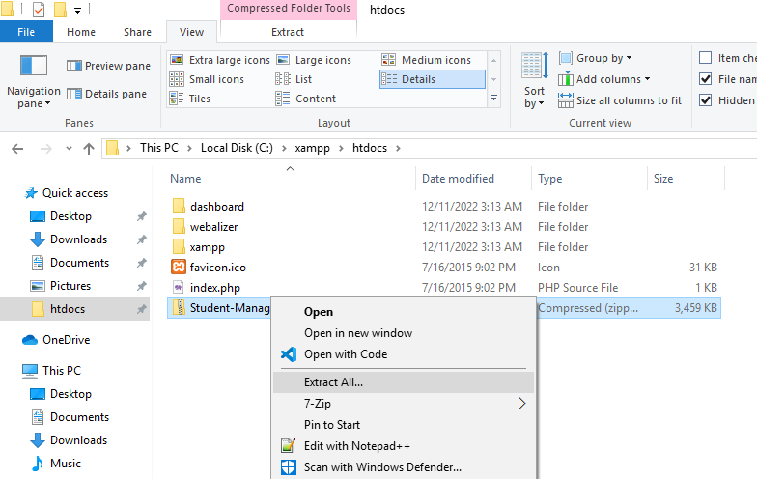
Move Downloaded file to
Xampp htdocs folder
Click “Extract All”

Slide 15
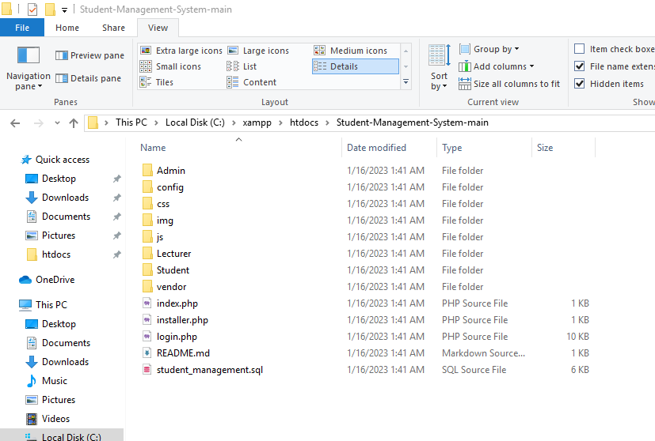
}
Open extracted Folder

Slide 16
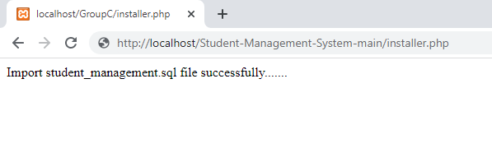
Now you need to go to this URL.
http://localhost/< Your Folder Path>/installer.php
http://localhost/Student-Management-System-main/installer.php
You can run our student management system by using this URL.
http://localhost/< Your Folder Path >
http://localhost/Student-Management-System-main

Slide 17
System coding explanation

Slide 18
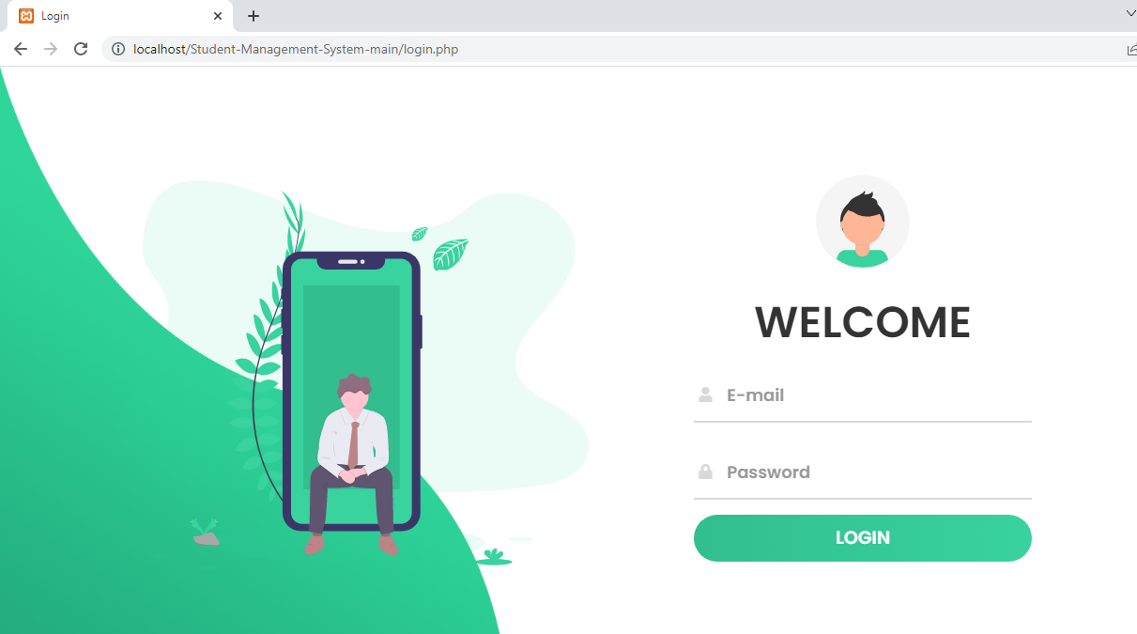
Login Interface
Login Data

Slide 19
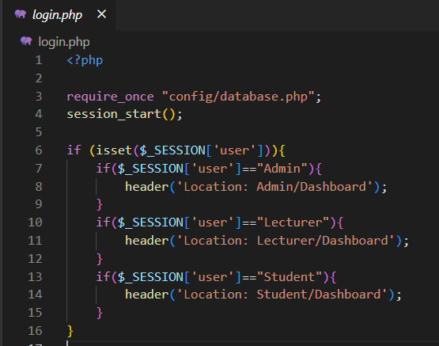
Login Coding
In this system, we store our database connection in one file because once our database username changes, we need to replace it on every page, so we store it in one file and import it to all files.
We use sessions to store
current username,
user types,
etc.

Slide 20
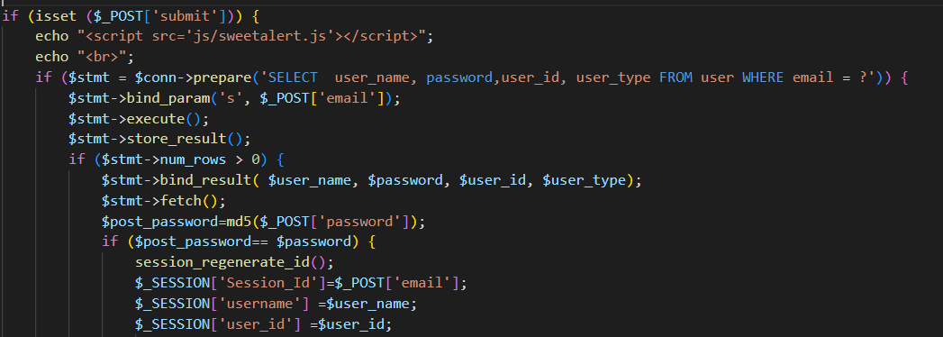
Login Coding
We use prepared statements because they are very useful against SQL injections.

Slide 21
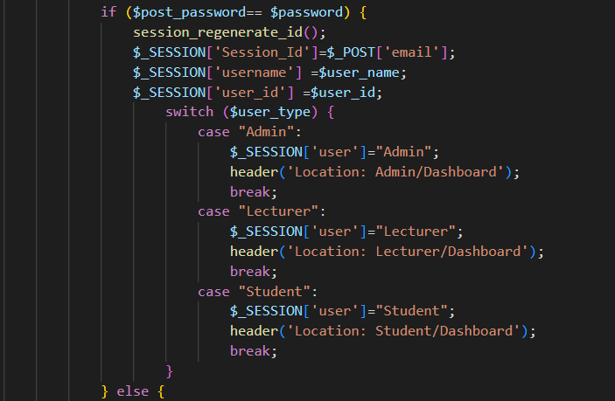
Login Coding

Slide 22
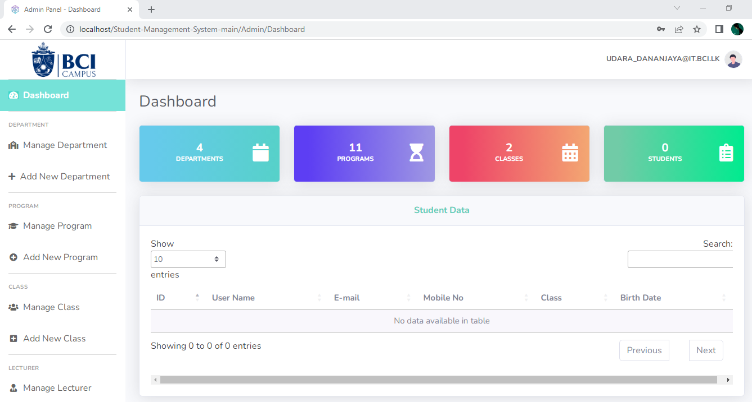
Dashboard

Slide 23
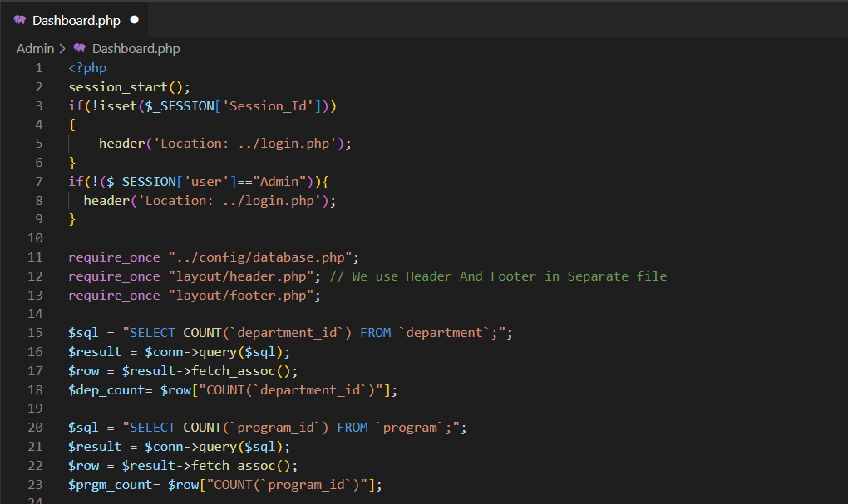
Dashboard

Slide 24
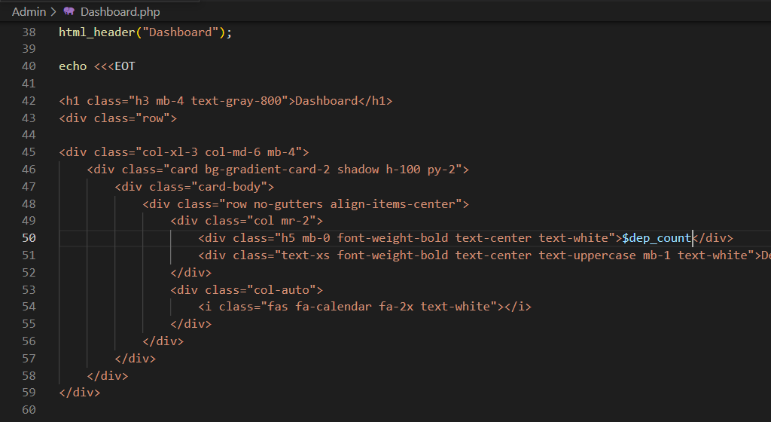
Dashboard

Slide 25
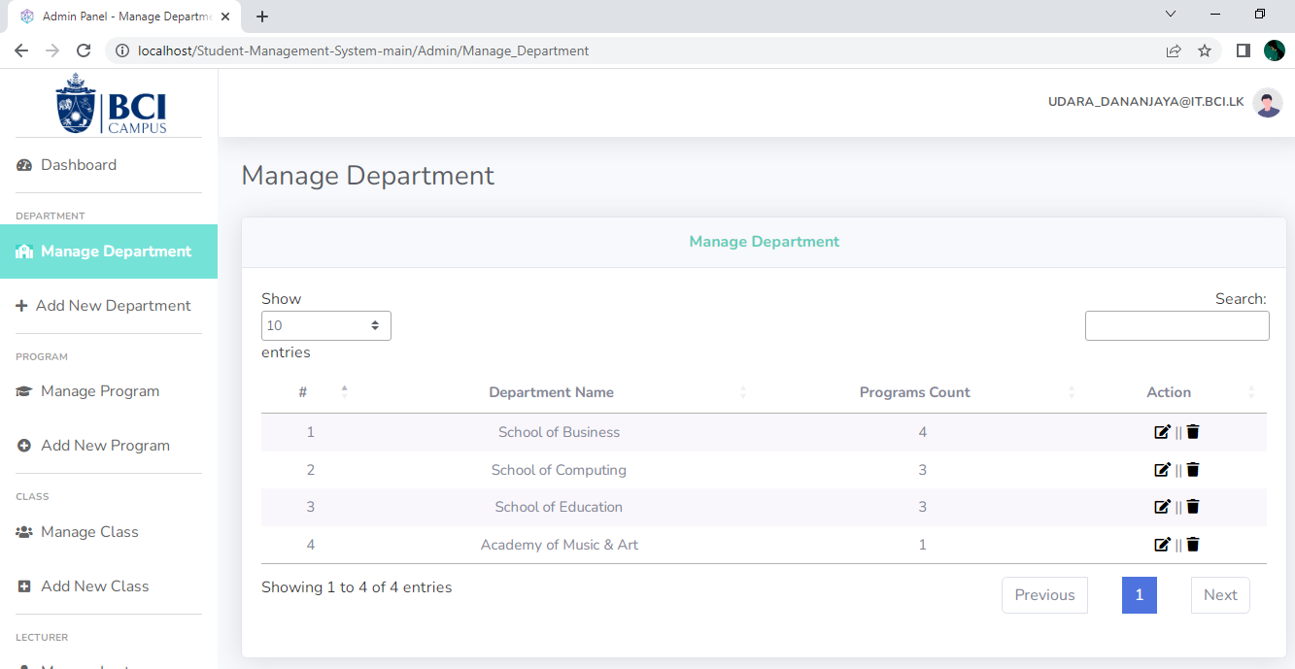
Manage Department

Slide 26
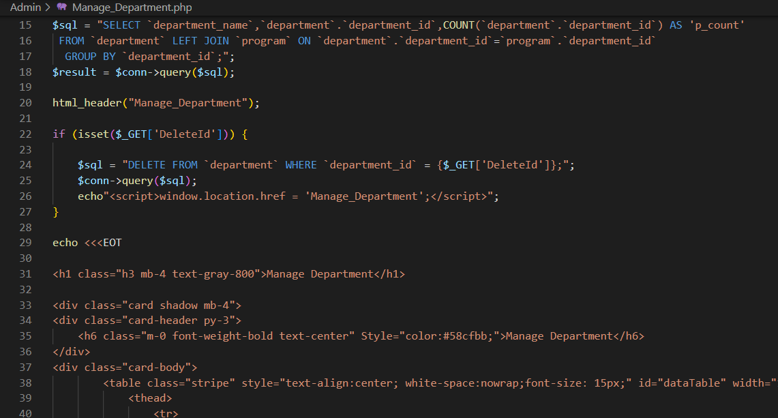
Manage Department

Slide 27
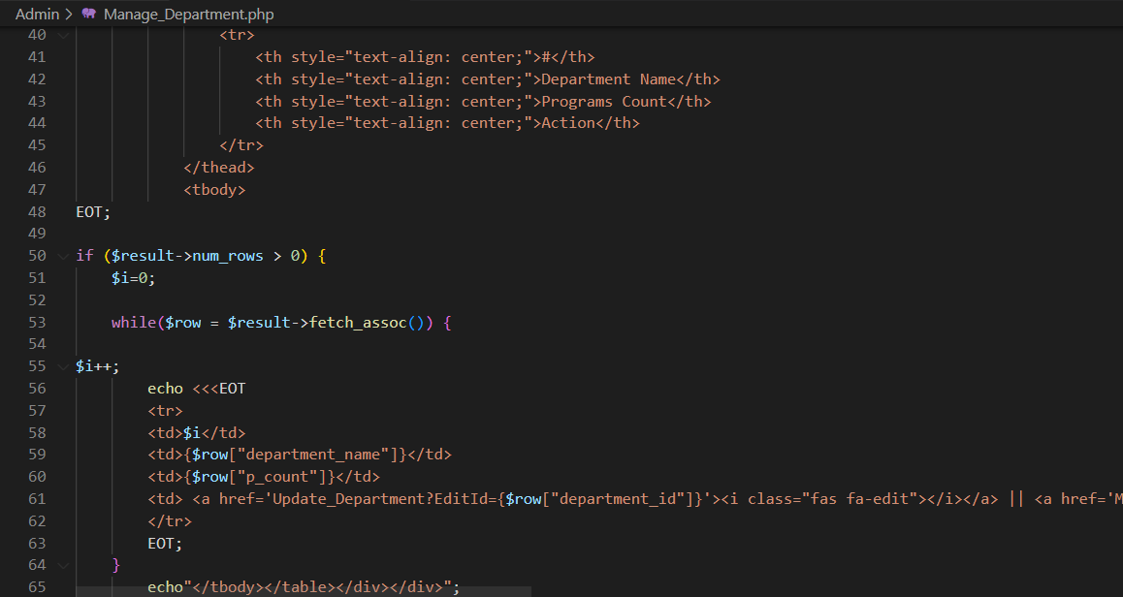
Manage Department

Slide 28
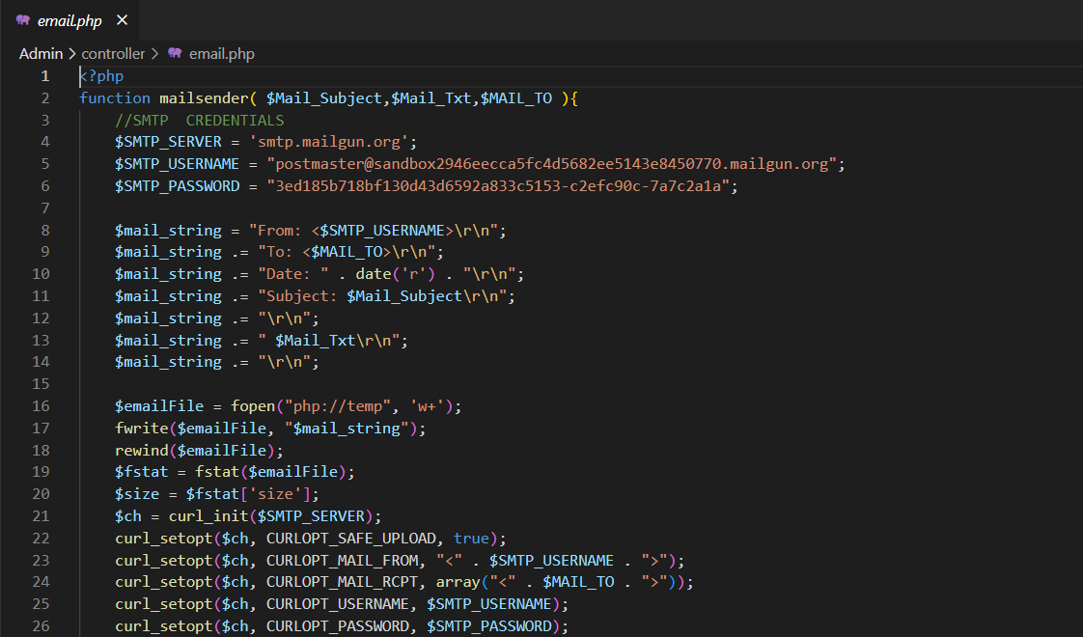
additional function

Slide 29
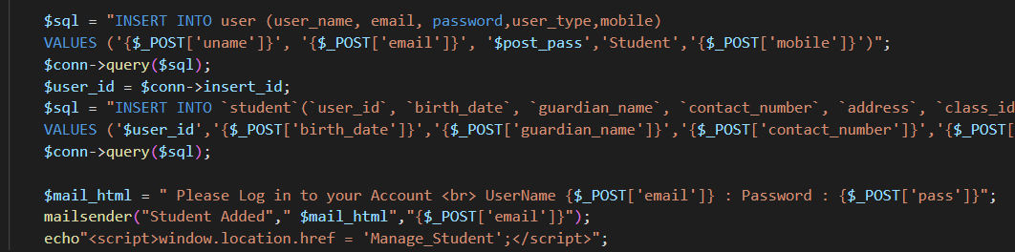
We use this function for sending the username and password. Because we cannot give a username and password. Physically, it is not practical.

Slide 30
dependency
Bootstrap ( For Designing)
Datatables (To get advanced features for HTML tables )
Fontawesome (icon library)
Jquery (feature-rich JavaScript library)
Sweetalert.js (customizable JavaScript's popup boxes.)

Slide 31
Thank you!
Megana Ariyarathna
Udara Aththanayaka
Enosh Rodrigo

